Slide 1
Understanding how to analyse bulk transcriptomic data using DESEq2
Taken largely from
Modern statistics for modern biology
https://www.huber.embl.de/msmb/

Slide 2
Frequentist statistics
A type of statistical inference that draws conclusions from sample data by emphasizing the frequency or proportion of the data.

Slide 3
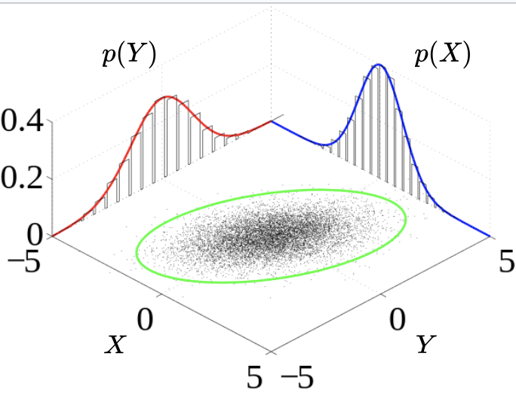
Generative model
All the parameters of the model are known
Given an observable variable X and a target variable Y, a generative model is a statistical model of the joint probability distribution on, P(X|Y).
probability of Y given X
X has already occurred and has been measured
Notes:
Generative models are our basic building blocks. In order to draw conclusions about complicated data it tends to be useful to have simple models for the data generated under this or that situation. We do this through the use of probability theory and generative models
joint probability distribution for X,Y,… is a probability distribution that gives the probability that each of X,Y,…
That is standard notation for conditional probability.
The notation P(x|y) means P(x) given event y has occurred, this notation is used in conditional probability.

Slide 4
Probability distributions
Probability distribution is a mathematical function that gives the probabilities of occurrence of different possible outcomes.
Mathematical description of the probabilities of events
Determined empirically from a distribution of data.
There are some commonly observed distributions – grouped by the process that they are related to

Slide 5
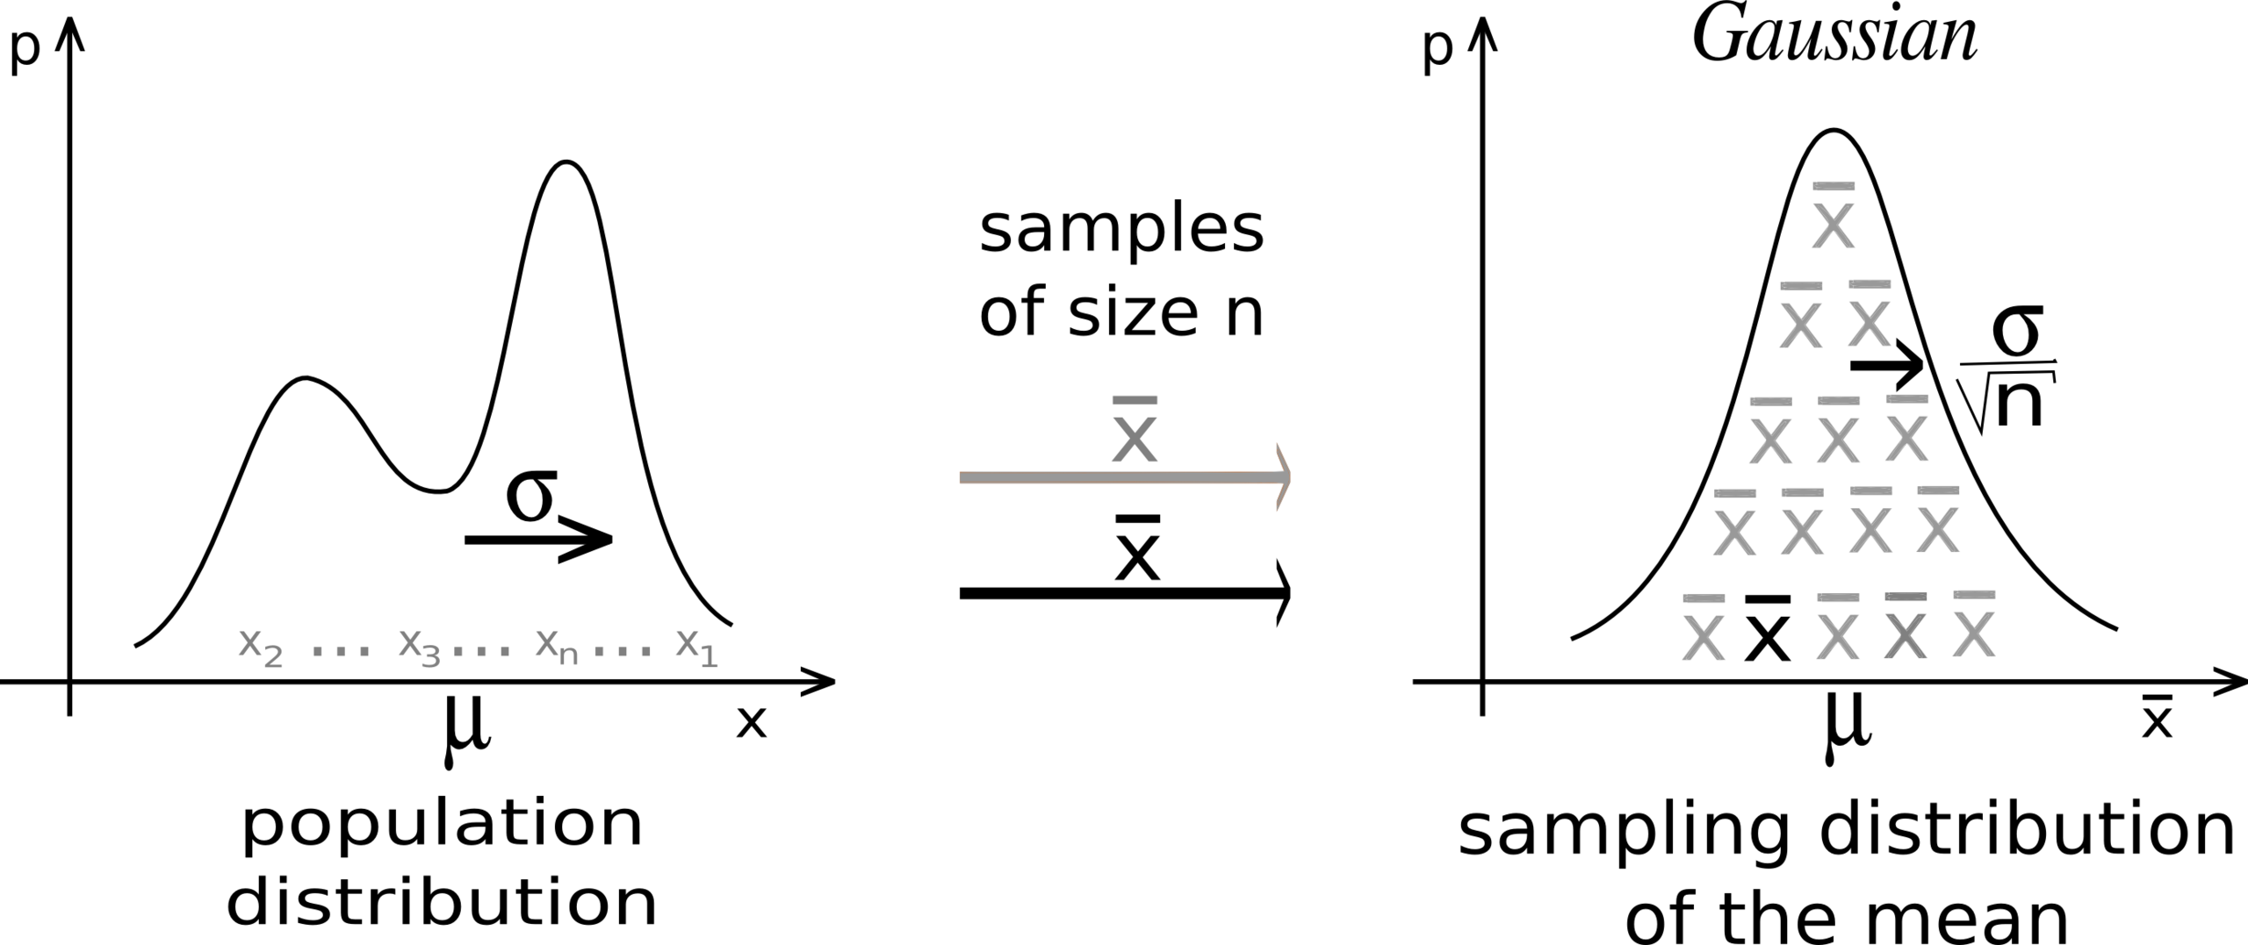
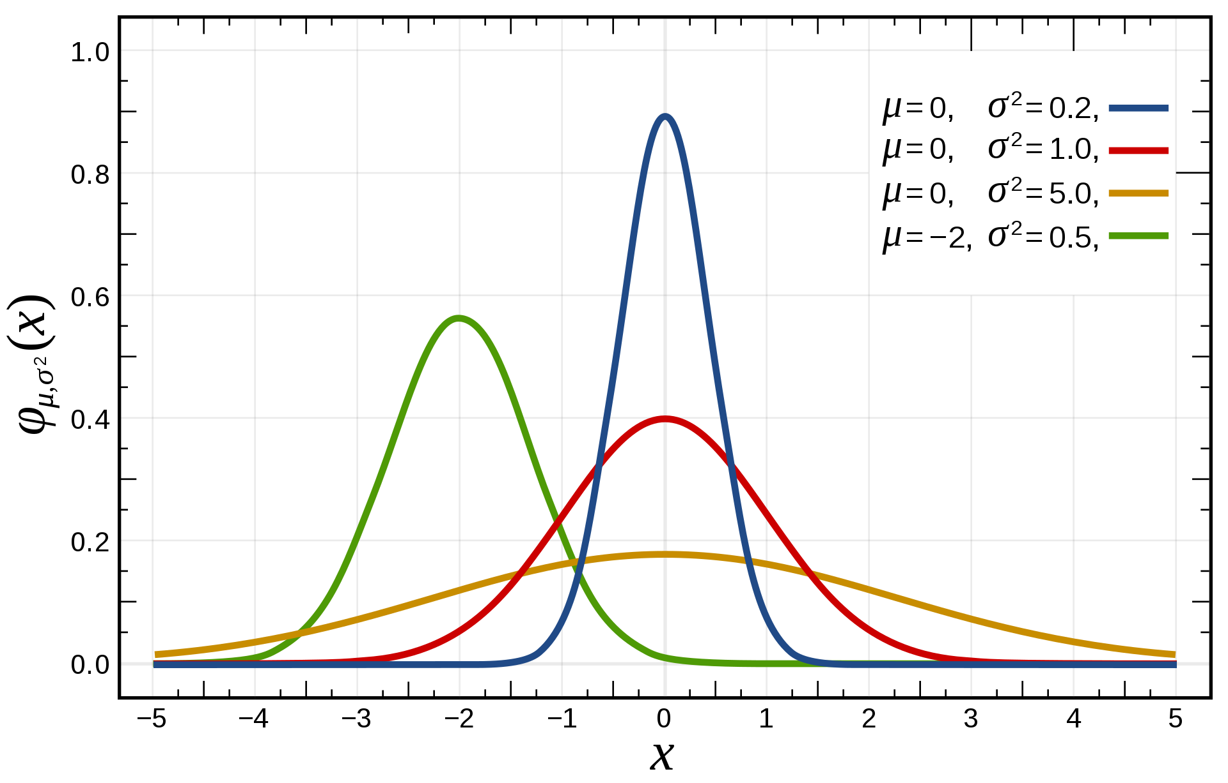
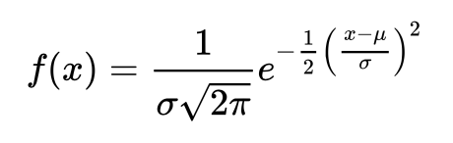

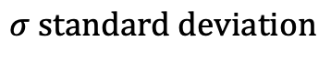
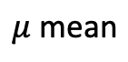
Normal (Gaussian) distribution
Most important distribution – central limit theorem.
$$\text{Probability} \text{density} \text{function}\text{:}$$
$$μ \text{mean}$$
$$σ standard deviation$$
Notes:
CLT = independent random variables are added, their normalizedsum tends toward a normal distribution even if the original variables themselves are not normally distributed
CLT = Even if your not normal the average is normal

Slide 6
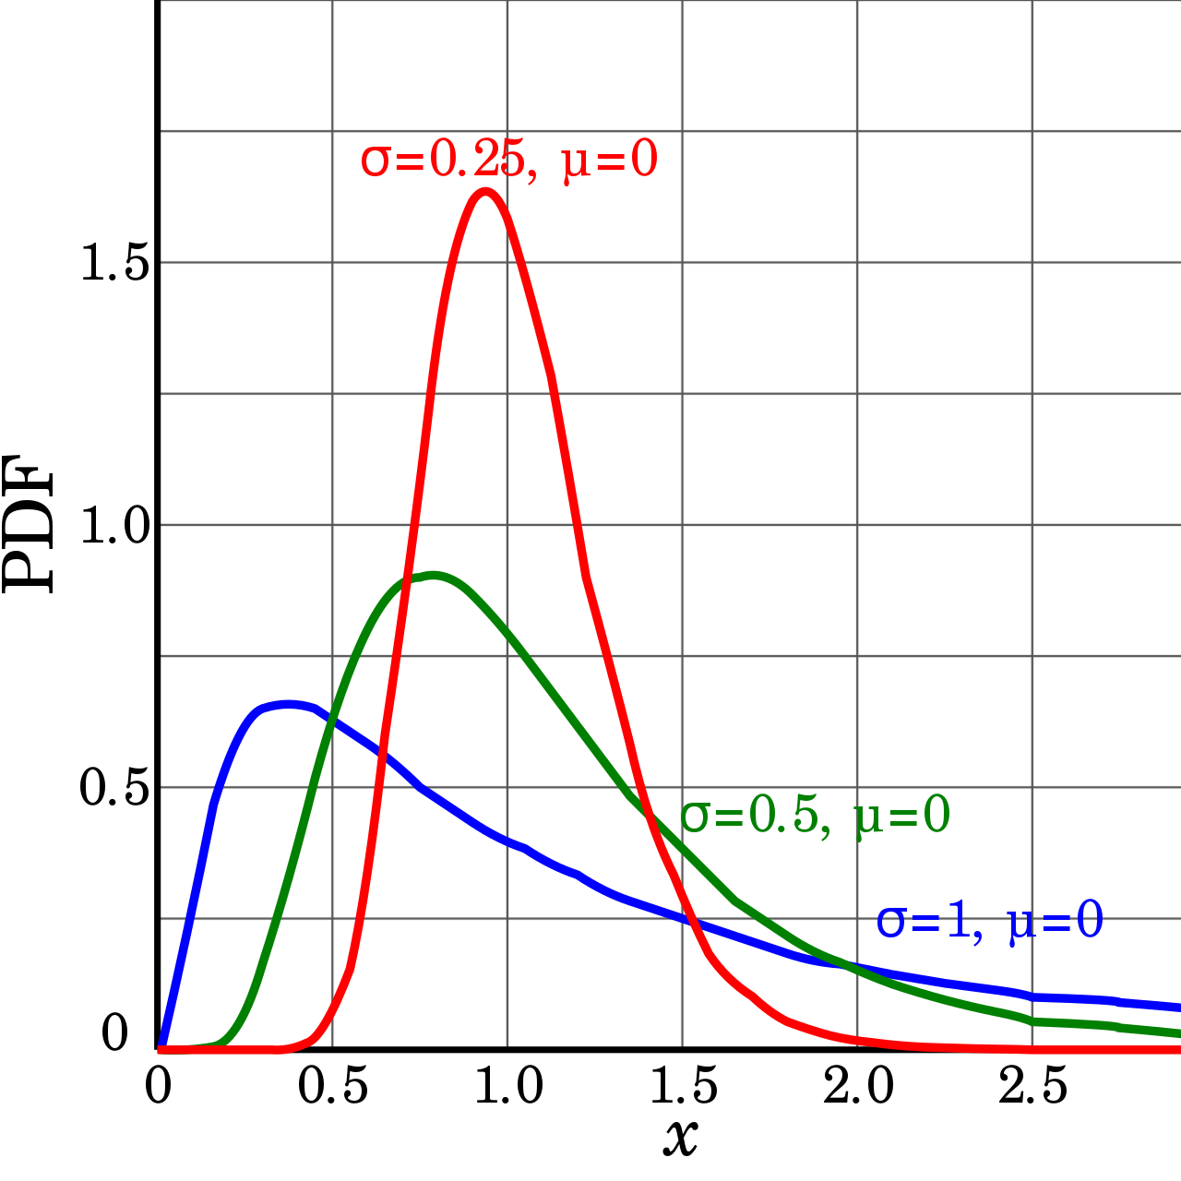
Log normal distribution
Probability distribution of a random variable whose logarithm is normally distributed.
Y = ln(X) has a normal distribution

Slide 7
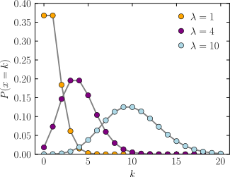
Possion distribution
a discrete probability distribution that expresses the probability of a given number of events occurring in a fixed interval of time or space if these events occur with a known constant mean rate and independently of the time since the last event
The horizontal axis is the index k, the number of occurrences. λ is the expected rate of occurrences. The vertical axis is the probability of k occurrences given λ.
Notes:
The Poisson distribution is used to model the number of events occurring within a given time interval. Counting the number of car accidents in a day

Slide 8
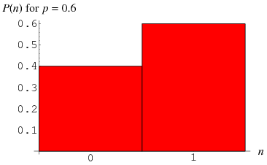
Bernoulli distribution
Discrete probability distribution of a random variable

Slide 9
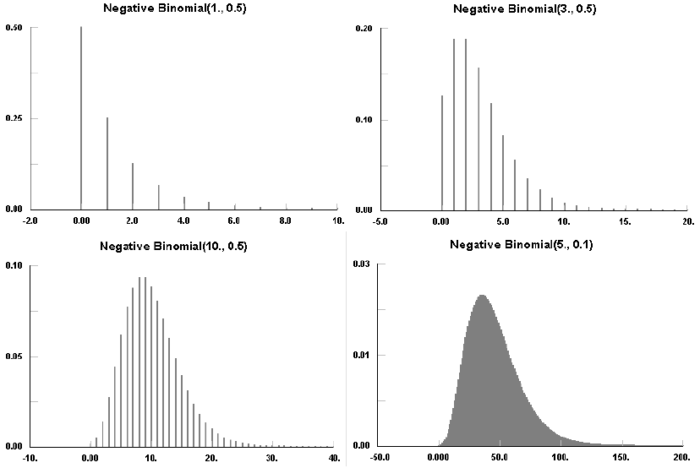
Negative binomial distribution
RNA-seq counts distribution
Notes:
The Negative Binomial distribution estimates the number of failures there will be before s successes are achieved where there is a probability p of success with each trial.

Slide 10
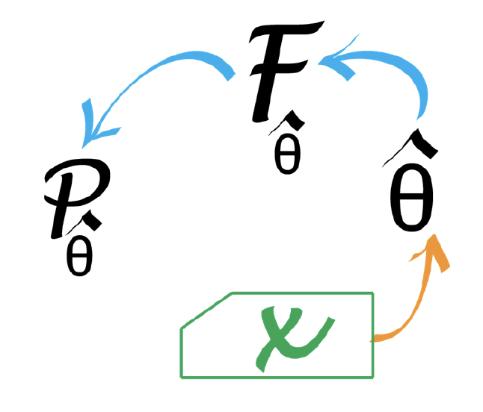
Statistical modelling
In many real situations, neither the generative model nor the parameters are known, and we will need to estimate them using the data we have collected
Statistical modelling works from the data upwards to a model that might plausibly explain the data
This upward-reasoning step is called statistical inference
We start with data X and use this to estimate the parameters of a distribution. These estimates are donated by Greek letters and a hat.

Slide 11
Statistical modelling
How do we pick which generative model is best for your data?
Statistical detective
First we need a reasonable probability distribution to model the data generation process
Our first step is to find a fit from candidate distributions; this requires consulting graphical and quantitative goodness-of-fit plots.

Slide 12
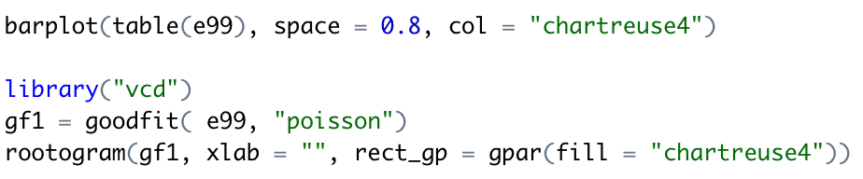
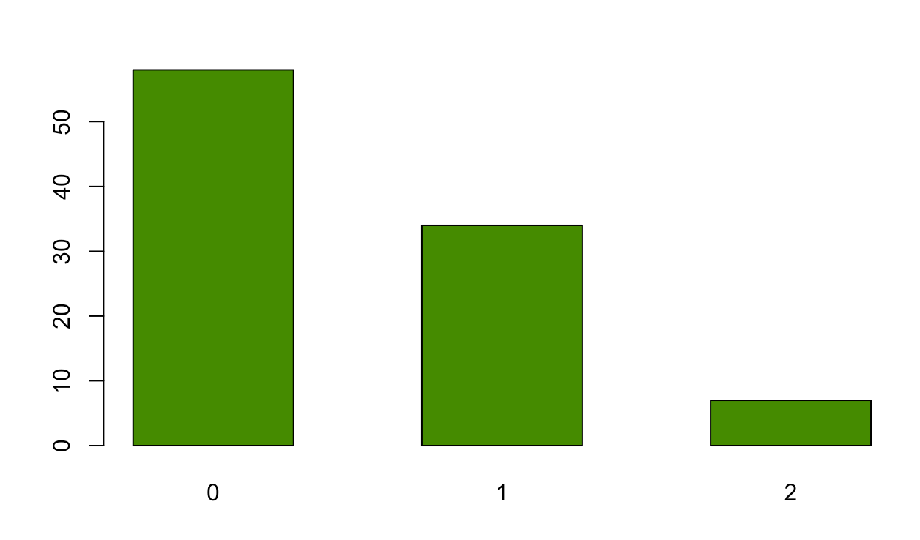
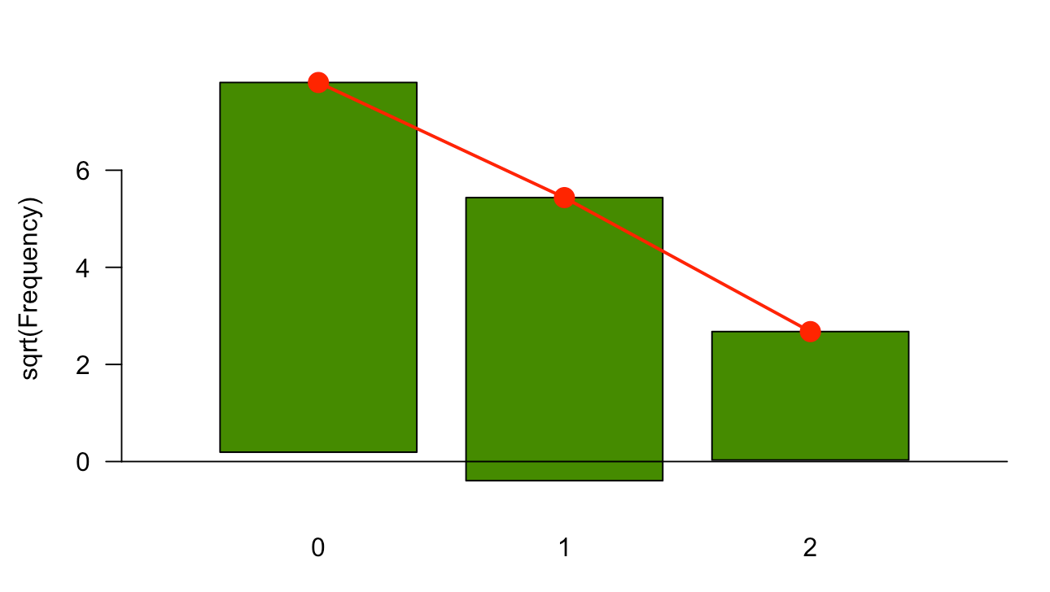
Rootograms
Red is theoretical distribution
Bottom of bar should align with horizontal
Assess goodness of fit

Slide 13
Bayesian statistics
A method of statistical inference in which Bayes theorem is used to update the probability for a hypothesis as more evidence or information becomes available.
Practical approach where a prior and posterior distribution are used to model.
Prior – probability that would express ones belief before evidence is taken into account. This unknown would maybe be a parameter of the model or a latent variable rather than an observable variable.
Posterior – random variable conditional on the evidence obtained for an experiment after the relevant evidence is taken into account
Notes:
Posterior - means after taking into account the relevant evidence related to a particular thing being examined.

Slide 14
Bayesian statistics
We use probability distributions to express our knowledge about the parameters, and then use data to update our knowledge.
For example, shifting the distributions and making them narrower (more to come later).

Slide 15
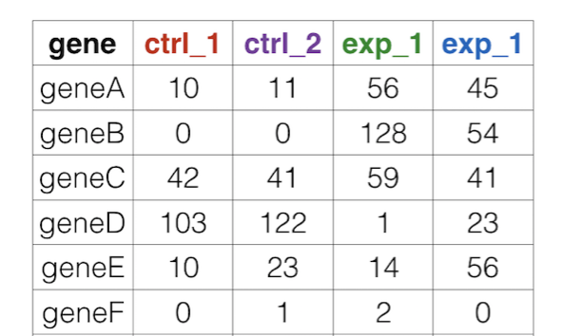
High-throughput count data
Challenges:
Large dynamic range - 0 to millions. (heteroscedasticity).
Non negative integers with uneven distributions – normal or log-normal distributions may not fit.
We need to understand the sampling biases and correct.
Small sample size makes estimation of dispersion difficult.

Slide 16
Normalisation
Normalisation can be misleading term
Nothing to do with normal distribution
The aim is to identify sources of bias and take them into account
For RNA-seq that’s usually library size (number of reads for each sample)

Slide 17
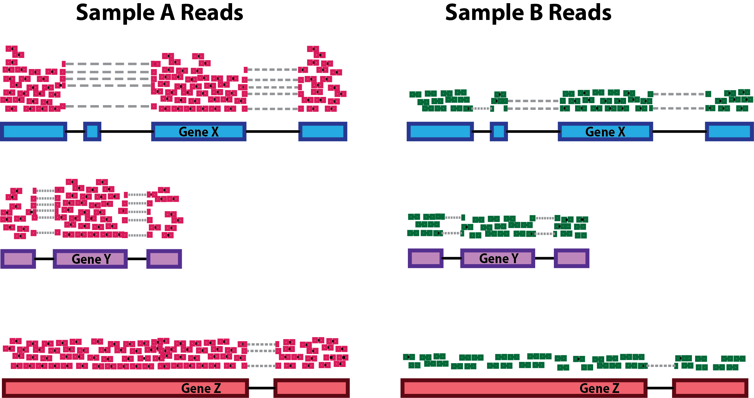
Normalisation

Slide 18
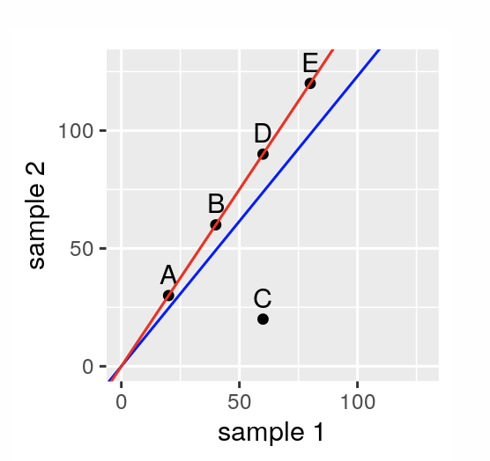
Normalisation
Consider this:
If we estimate s for each of two samples by the sum of its counts then the slope of the blue line represents their ratio.
Gene C is downregulated in sample 2 while the other genes are upregulated
If we now estimate s such that the ratios correspond to the red line.
Only gene C is downregulated in sample 2
The slope of the red line is generated using robust regression – This is what DEseq2 does.
Size factor estimation. The points correspond to hypothetical genes whose counts in two samples are indicated by their xx- and yy-coordinates. The lines represent ways of estimating size factor.
Notes:
S is the size factor

Slide 19
Dispersion
Fragments are cDNA molecules that could be sequenced (in reality we only sequence a fraction of these in the total sample).
A sequencing library of n₁ fragments corresponding to gene 1, n₂ corresponding to gene 2.
A total library size is n = n₁ + n₂ + ..n_{n}

Slide 20
Dispersion
The number of genes is in the tens of thousands
The value of n (fragments) depends on the amount of cells that were used to prepare the lib, which could potentially be billions
We submit the sample for sequencing and determine the identity of r randomly sampled fragments.
The number of reads r is usually in the tens of millions

Slide 21
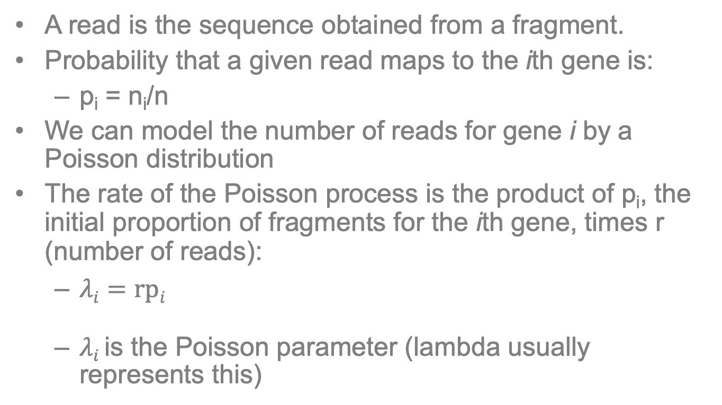
Dispersion
A read is the sequence obtained from a fragment.
Probability that a given read maps to the ith gene is:
p_{i} = n_{i}/n
We can model the number of reads for gene i by a Poisson distribution
The rate of the Poisson process is the product of p_{i}, the initial proportion of fragments for the ith gene, times r (number of reads):
$λi=rpi$
$λi$ is the Poisson parameter (lambda usually represents this)
Notes:
Possion parameter, λ, lambda, the rate parameter
Lambda can be thought of as the expected number of events in the interval

Slide 22
Dispersion
In practice we aren’t usually interested in modelling the counts of the single library but between libraries
That’s the difference between control and treatment
It turns out that replicates vary more than the Poisson distribution
We need to model this so we instead use a Gamma-Poisson (aka. Negative binomial) distribution which better suits our modelling needs

Slide 23
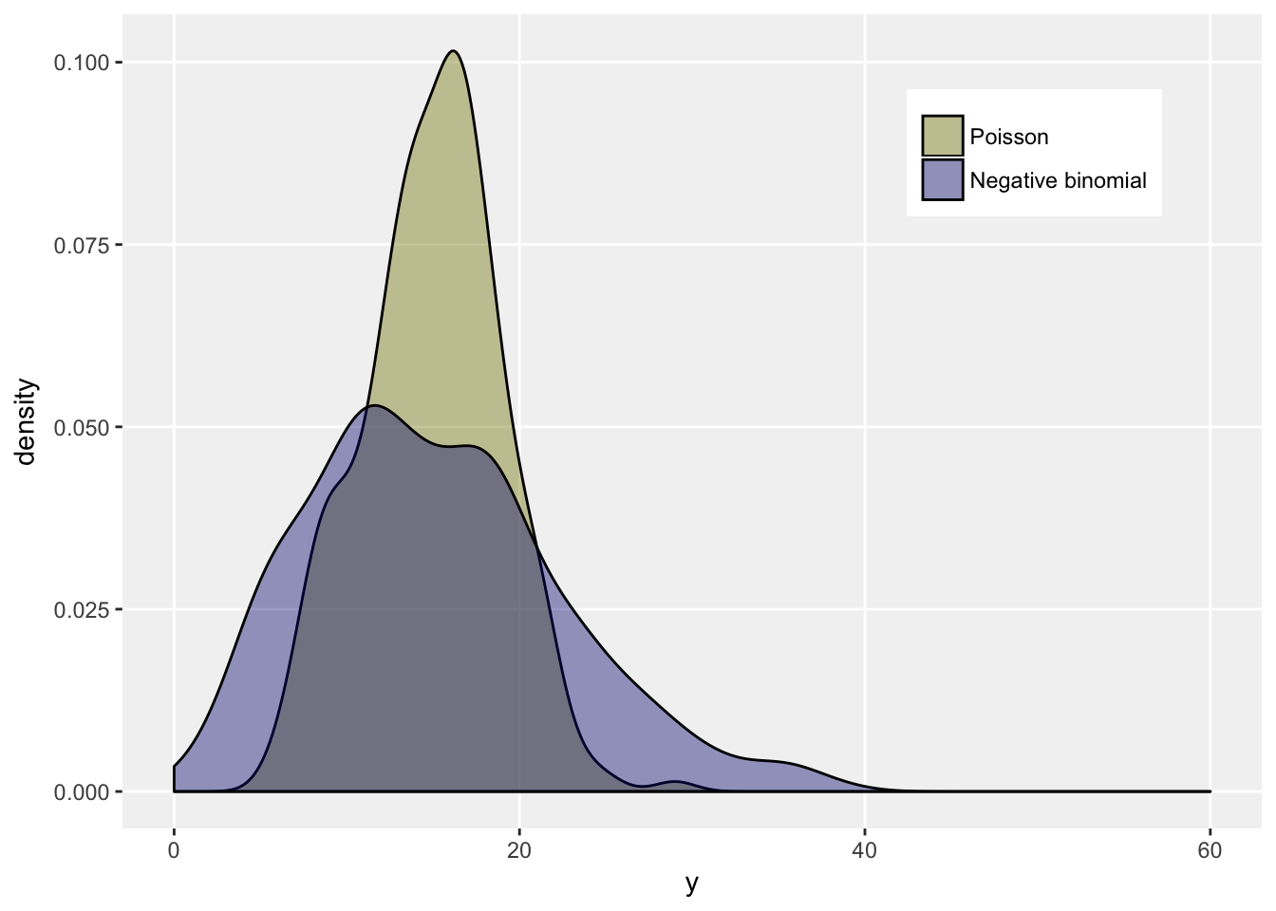
Dispersion

Slide 24
We are now ready to fit a model (GLM)
But before GLM we need to understand linear modelling

Slide 25
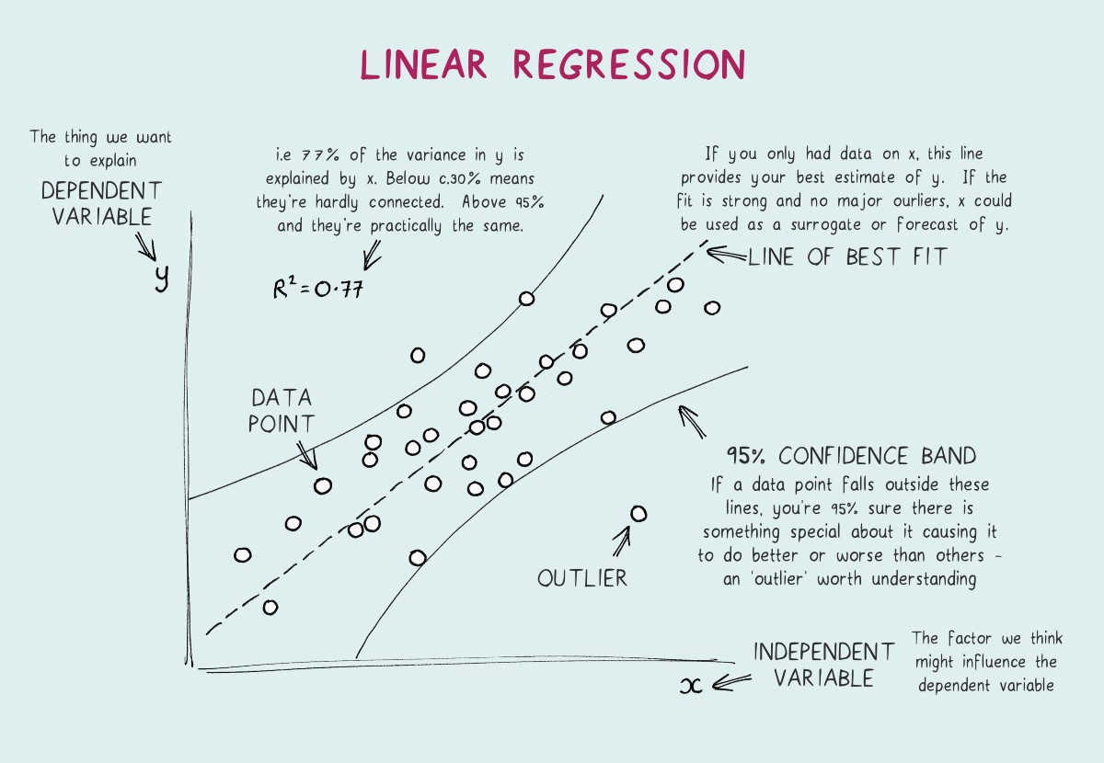
Linear model

Slide 26
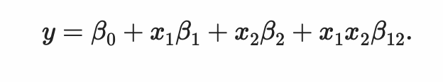

Linear models
We perform an siRNA knockdown of CTLA-4 gene. We also want to study the effect of a drug X.
We treat cells with neg control, siRNA alone, drug X alone or both:
y is the experimental measurement of interest i.e. the transformed expression level of a gene
The coefficient $β$₀ is the base level of the measurement in control (a.k.a. the intercept)
$𝓍$₁ and $𝓍2 are binary variables.$
$$𝓍\text{1} Takes value 1 if siRNA is administered$$
$𝓍2$ indicated whether drug was administered
Notes:
Coefficient - a numerical or constant quantity placed before and multiplying the variable in an algebraic expression (e.g. 4 in 4x ^{y}).
Beta - A beta weight is a standardized regression coefficient (the slope of a line in a regression equation).

Slide 27
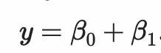
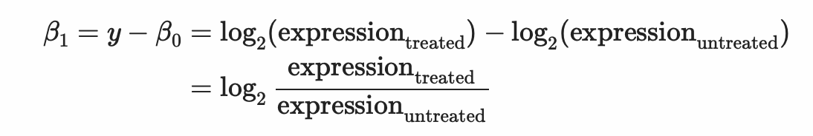
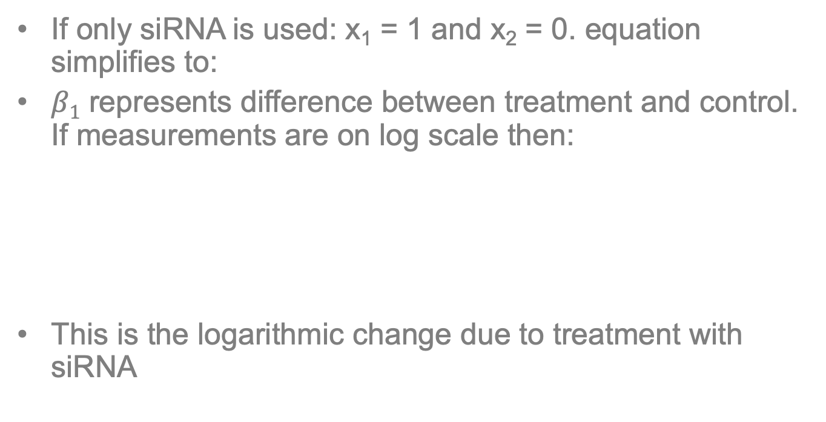
Linear models
If only siRNA is used: x₁ = 1 and x₂ = 0. equation simplifies to:
$β1$ represents difference between treatment and control. If measurements are on log scale then:
This is the logarithmic change due to treatment with siRNA

Slide 28
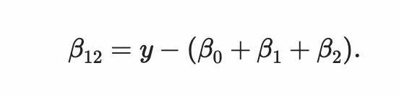
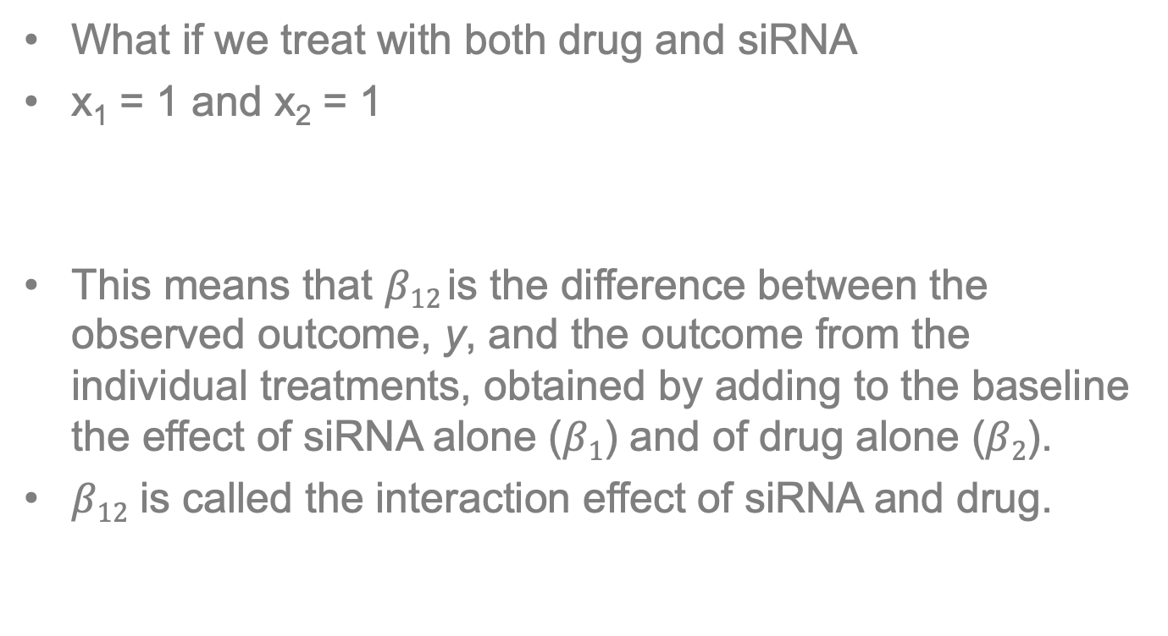
Linear models
What if we treat with both drug and siRNA
x₁ = 1 and x₂ = 1
This means that $β12$is the difference between the observed outcome, y, and the outcome from the individual treatments, obtained by adding to the baseline the effect of siRNA alone ($β1$) and of drug alone ($β2$).
$β12$ is called the interaction effect of siRNA and drug.

Slide 29
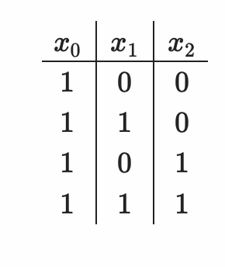
Design matrix
We can encode an experimental design in a matrix:
The columns represent experimental factors and rows represent the different experimental conditions

Slide 30
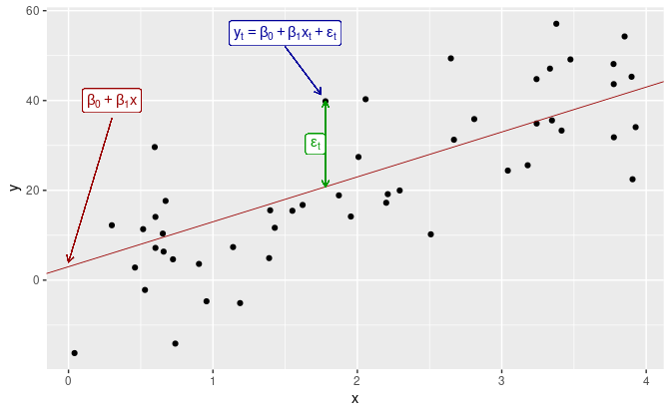
Linear model and noise
Notes:
The coefficients β0 and β1 denote the intercept and the slope of the line respectively. The intercept β0 represents the predicted value of y when x=0. The slope β1 represents the average predicted change in y resulting from a one unit increase in x.
Notice that the observations do not lie on the straight line but are scattered around it. We can think of each observation yt as consisting of the systematic or explained part of the model, β0+β1xt, and the random “error,” εt. The “error” term does not imply a mistake, but a deviation from the underlying straight line model. It captures anything that may affect yt other than xt.

Slide 31
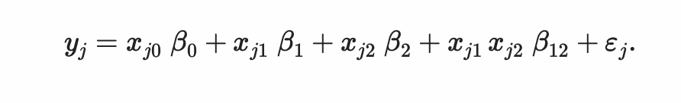


Noise and replicates
To estimate noise you need replicates
Assessment of uncertainty of our estimated $β$s
Extend equation:
Added the index j and a new term $ε$_{j}
The index now counts over our individual replicate experiments e.g. if for each of the four conditions we perform three replicates, then j counts from 1 to 12.
The design matrix has 12 rows, and x_{jk} is the value of the matrix in its jth row and kth column
Notes:
epsilon

Slide 32
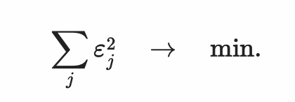
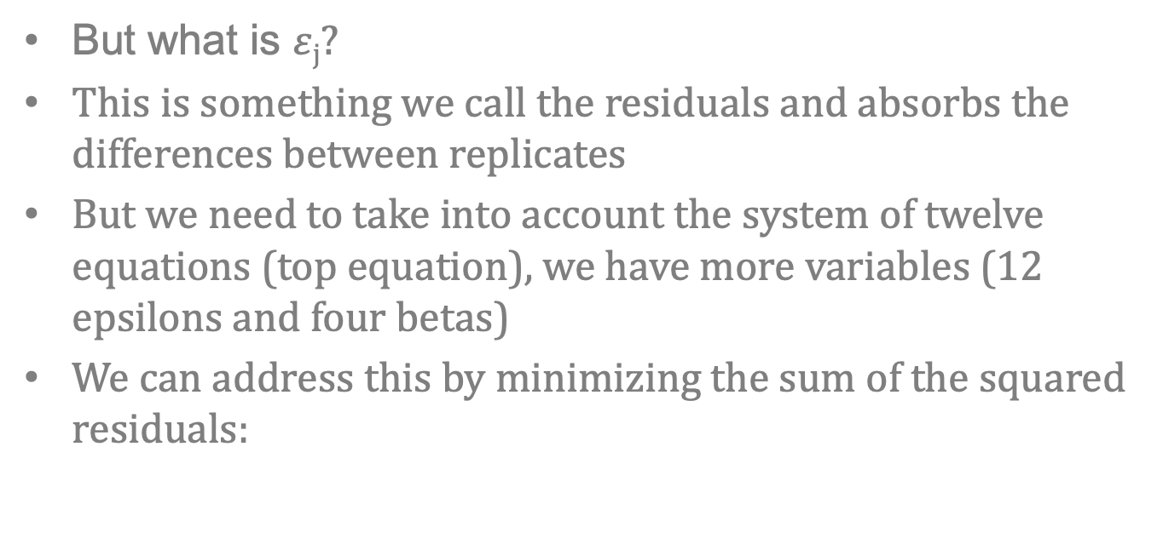
Noise and replicates
But what is $ε$_{j}?
This is something we call the residuals and absorbs the differences between replicates
But we need to take into account the system of twelve equations (top equation), we have more variables (12 epsilons and four betas)
We can address this by minimizing the sum of the squared residuals:
Notes:
Residual is just the error of our result. It is the difference between the observed and the expected value of our quantity of interest

Slide 33
General linear model for counts
The above equation models the the expected value of the outcome y, as a linear function of the design matrix, and its fitted to the data according to the least sum of squares
We now want to generalize these assumptions

Slide 34
General linear model for counts
Modelling data on a transformed scale:
It can be more fruitful to consider data on a scaled level than its natural scale level – this can be generalized
Error distributions:
Other generalized concerns are the minimization criteria
Generalization can make is to use a different probabilistic model than the normal distribution – in our case we know that we can deal with our counts data using a gamma-Poisson distribution (negative binomial distribution)
Notes:
Generalization refers to your model's ability to adapt properly to new, previously unseen data, drawn from the same distribution as the one used to create the model.

Slide 35
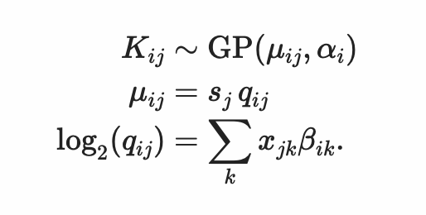
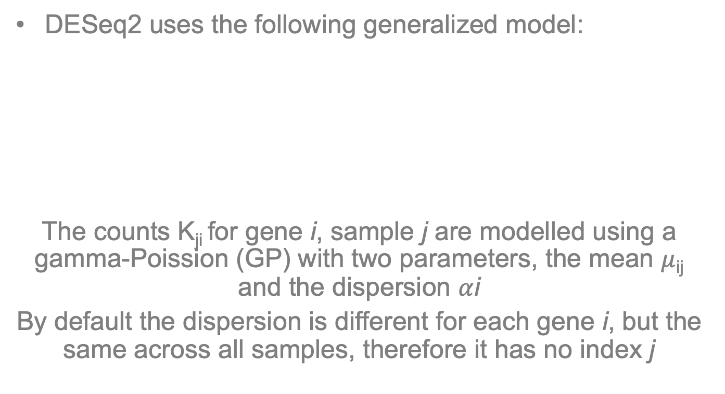
General linear model for counts
DESeq2 uses the following generalized model:
The counts K_{ji} for gene i, sample j are modelled using a gamma-Poission (GP) with two parameters, the mean $μ$_{ij} and the dispersion $α$i
By default the dispersion is different for each gene i, but the same across all samples, therefore it has no index j

Slide 36
General linear model for counts
The next equation states that the mean is composed of a specific size factor s_{j} and q_{ij}, which is proportional to the true expected concentration in fragments (sequencing reads) for gene i in sample j
q_{ij} – is given by the linear model in third equation by the link function, log₂

Slide 37
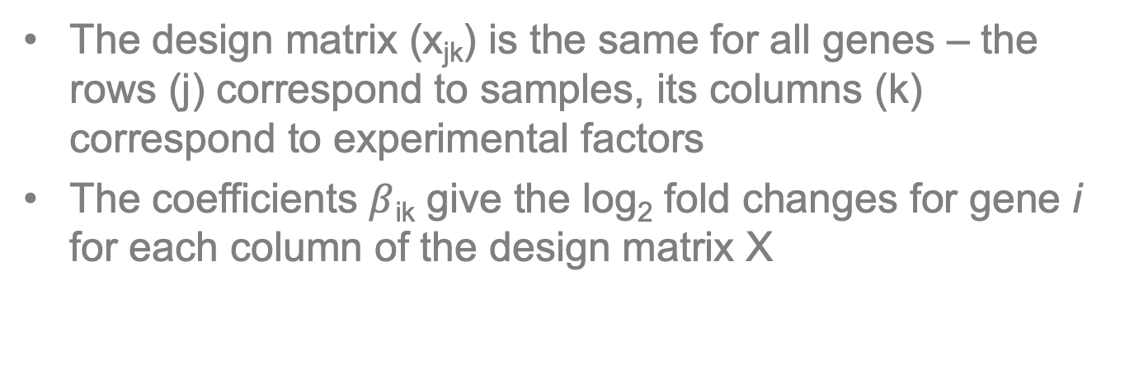
General linear model for counts
The design matrix (x_{jk}) is the same for all genes – the rows (j) correspond to samples, its columns (k) correspond to experimental factors
The coefficients $β$_{ik} give the log₂ fold changes for gene i for each column of the design matrix X

Slide 38
Sharing dispersion
In RNA-seq you typically only have a few replicates
Difficult to estimate within group variability
Solution is to pool information across genes which are expressed at a similar level
Assumes strength of similar average expression strength have similar dispersion
Notes:
Dispersion is large for lowly expressed genes
Draw on board relationship between dispersion and mean then fold change and mean

Slide 39
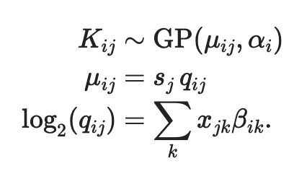
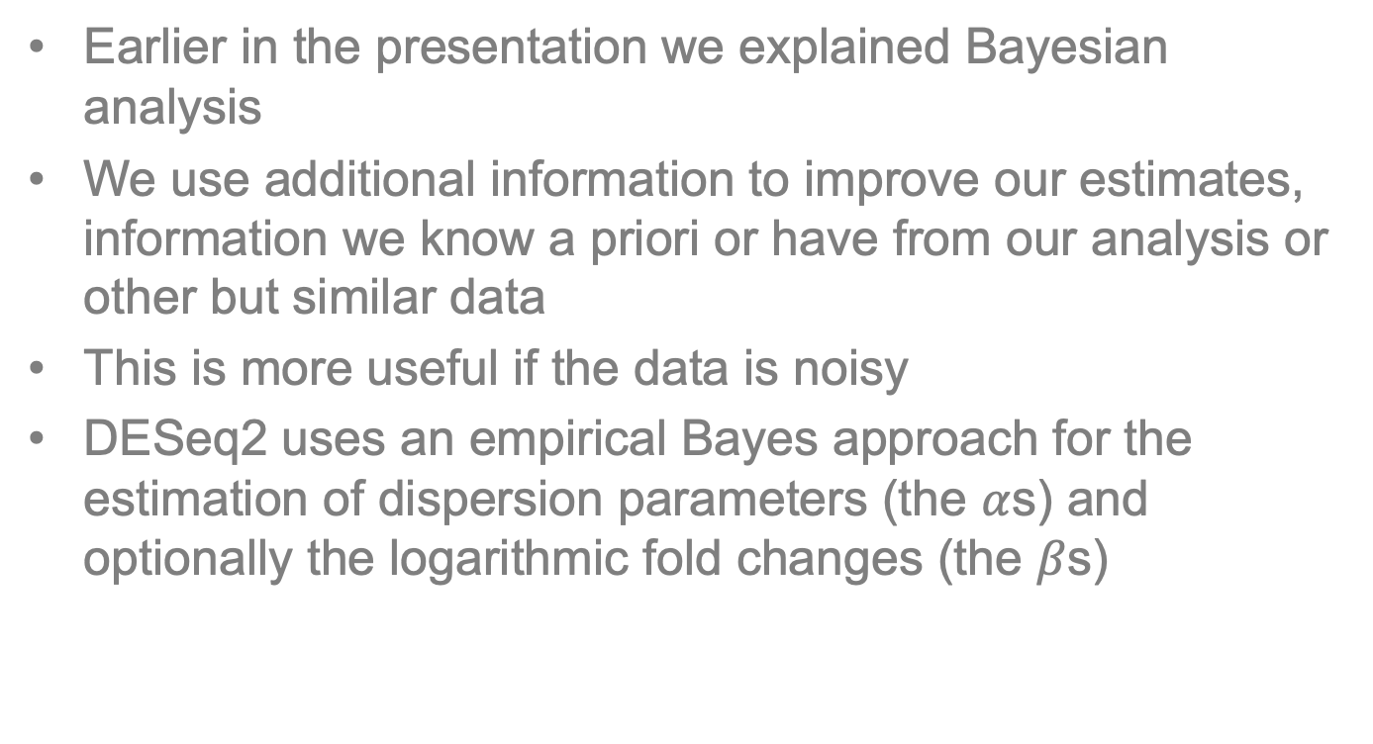
Sharing dispersion info
Earlier in the presentation we explained Bayesian analysis
We use additional information to improve our estimates, information we know a priori or have from our analysis or other but similar data
This is more useful if the data is noisy
DESeq2 uses an empirical Bayes approach for the estimation of dispersion parameters (the $α$s) and optionally the logarithmic fold changes (the $β$s)
Alpha is dispersion

Slide 40
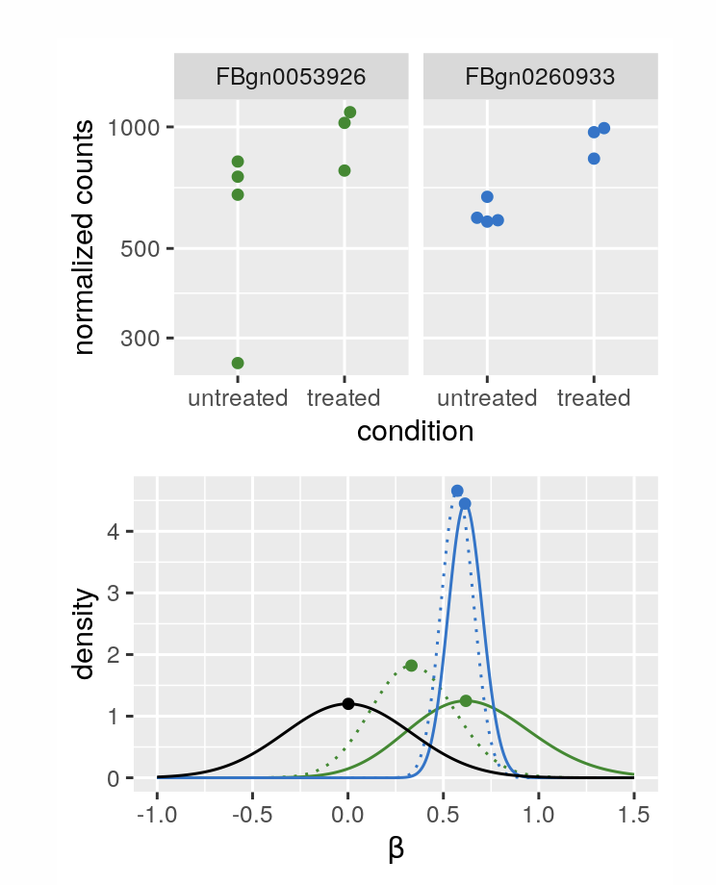
Sharing dispersion info
The priors are taken from the distributions of the maximum likelihood estimates (MLEs) across all genes
Likelihood function measures the goodness of fit of a model
So for MLE we are selecting the best probability distribution that is optimal for estimating the parameters of our distribution

Slide 41
Sharing dispersion info
Shrinkage estimation of logarithmic fold change estimates by use of empirical prior in DESeq2.
Two genes with similar means and MLE logarithmic fold change are in blue and green
Low dispersion for blue and high for green
Lower panel – density plots are shown of normalized likelihoods (solid lines) and the posteriors (dashed lines). Black shows prior estimates from MLE of all genes
Higher dispersion of green = likelihood is wider and less sharp, the prior has more influence on the posterior than in the blue case
Notes:
In Bayesian statistics, the posterior probability of a random event or an uncertain proposition is the conditional probability that is assigned after the relevant evidence or background is taken into account.
Posteriors – before relevant evidence is taken into account
logarithmic fold changes (the $β$s)

Slide 42
Sharing dispersion info
This means that the Bayes machinery “shrinks” each per-gene
The amount depends on the sharpness of the peak
Mathematics is explained in detail in
Love et al 2014

Slide 43
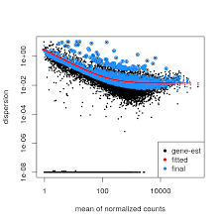
Dispersion
Estimates genewise dispersion using maximum likelihood
Fits a curve to measure dependence of these estimates on the average expression strength
Shrinks gene wise values towards the curve using an empirical Bayes approach (more later)
Each dot is gene and if it has low expression the variability is high.
Blue is the final genes that have been “pulled” towards the red line
Variability
Expression level

Slide 44
Wald test
Once a GLM is fitted then a wald test is performed for the treatment coefficient
The Wald test (also called the Wald Chi-Squared Test) is a way to find out if explanatory variables in a model are significant. “Significant” means that they add something to the model; variables that add nothing can be deleted without affecting the model in any meaningful way.
For large values of n, the Wald test is roughly equivalent to the t-test; both tests will reject the same values for large sample sizes.

Slide 45
LRT test
Analyze all levels of a factor at once
LRT which is used to identify any genes that show change in expression across the different levels
This type of test can be especially useful in analyzing time course experiments

Slide 46
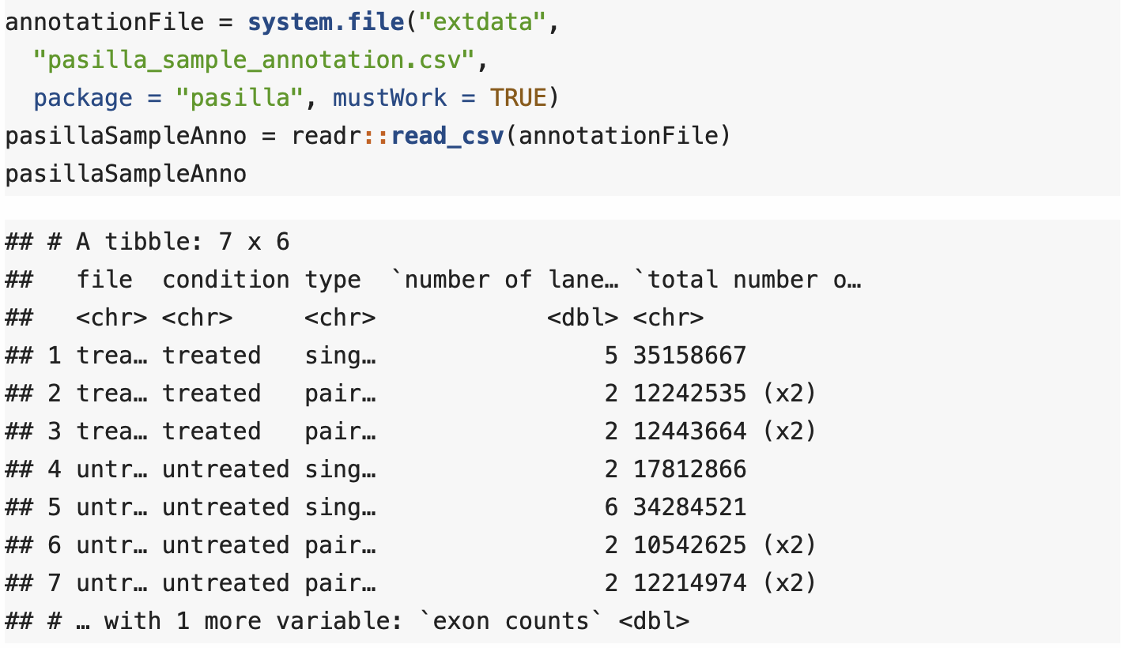
DESeq2 analysis

Slide 47
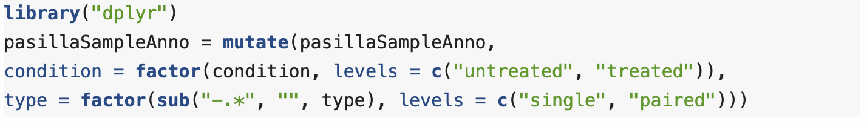
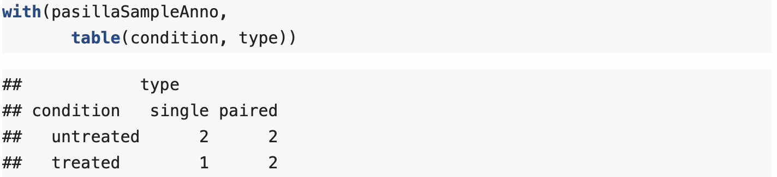
DESeq2 analysis

Slide 48
Counts data
We have an associated counts matrix for this data e.g.:

Slide 49
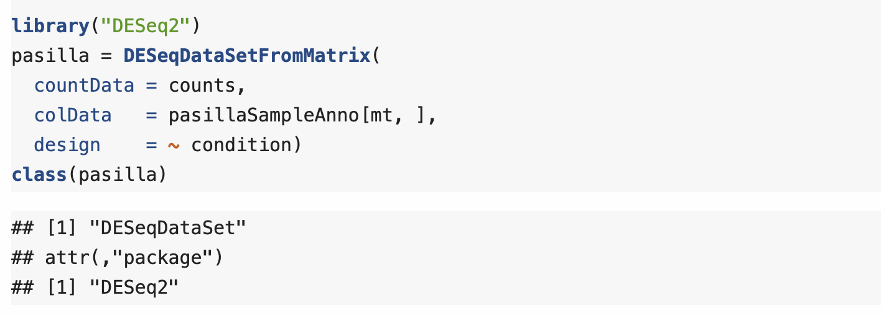
DESeq2 analysis

Slide 50
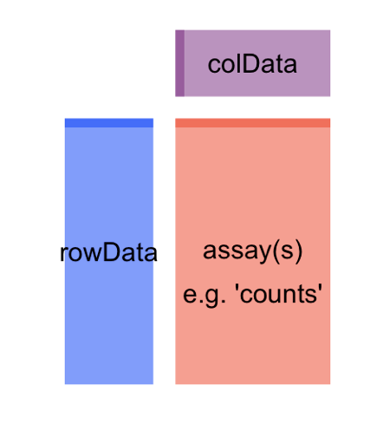
DESeq object
Based on the SummarizedExperiment class

Slide 51

DESeq2 analysis

Slide 52
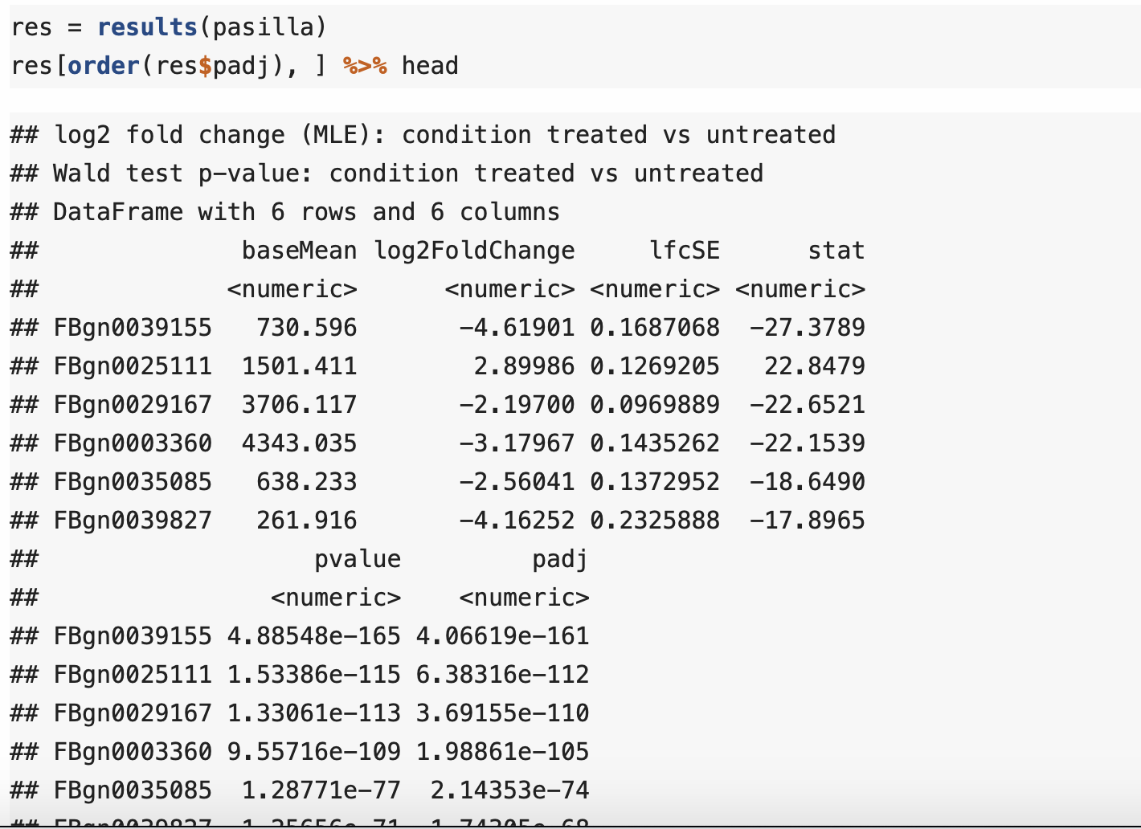
DESeq2 analysis

Slide 53
Exploring the results
There are four main plots that explain a lot about your data:
The histogram of p values
The MA plot
An ordination plot
A heatmap

Slide 54

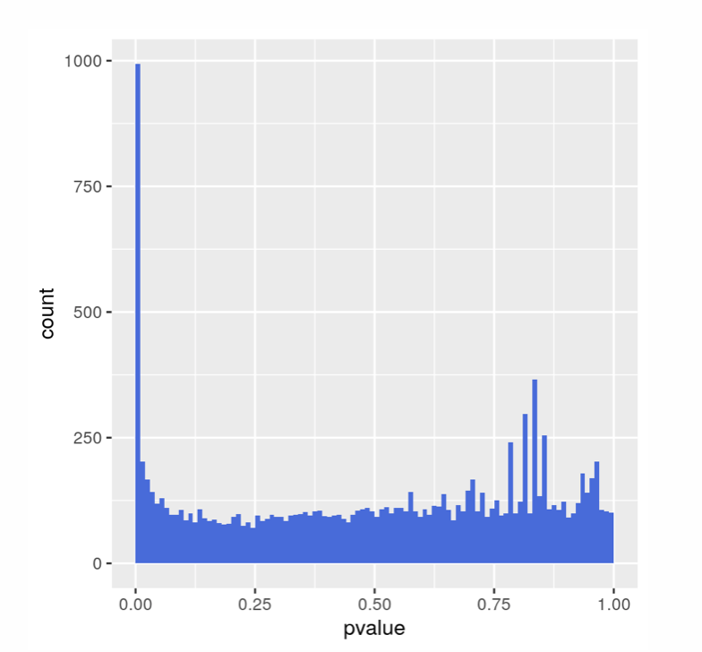
Exploring the results
The left hand peak is differentially expressed genes.
Background is right hand.
Pvalue < 0.01 ~ 990 genes.
The background is around 100 genes.
This suggests 10% FDR.
A shifted background distribution could indicate batch effects.

Slide 55

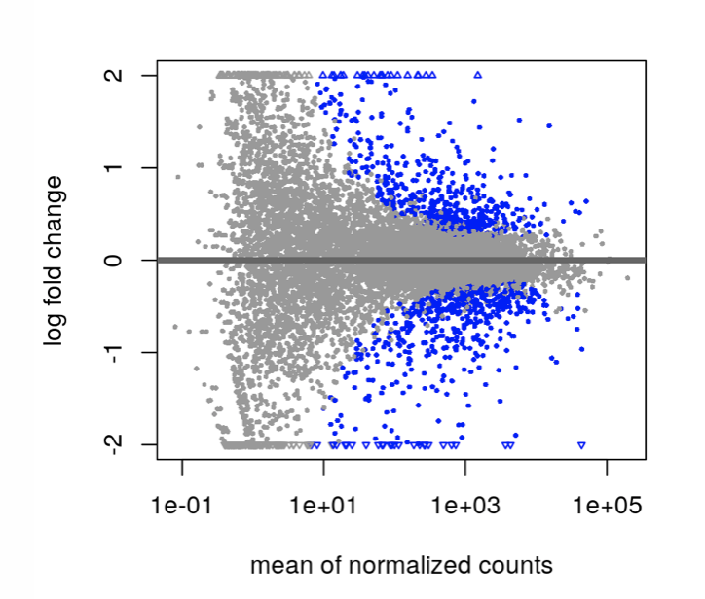
Exploring the results
Fold changes vs mean of size-factor normalized counts
Log scale for both axes
Blue points are significant genes

Slide 56
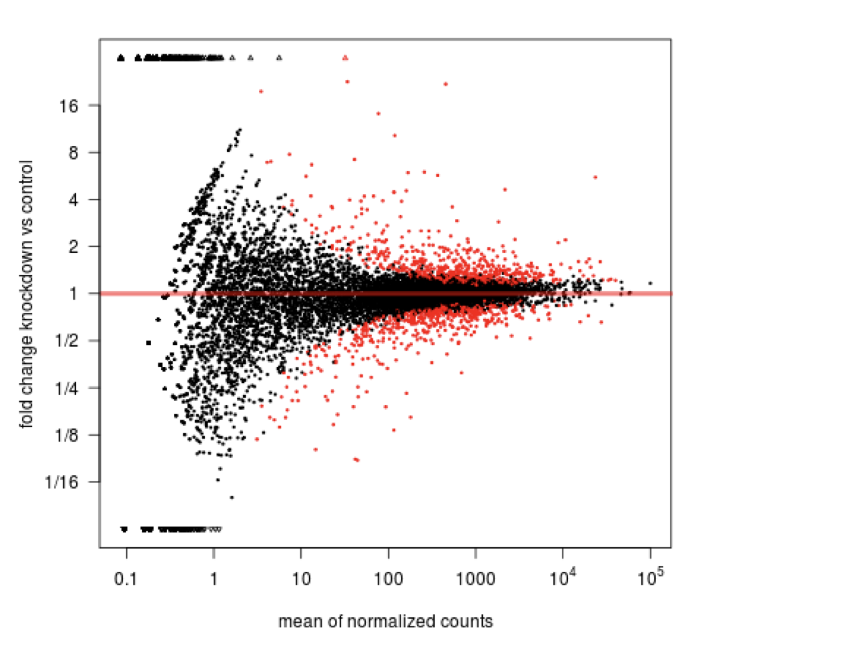
Shrinkage estimation
Weak genes have exaggerated effect sizes

Slide 57

Shrinkage estimation

Slide 58
Shrinkage estimation
Fit GLM for all genes without shrinkage
Estimate normal empirical-Bayes prior from non-intercept coefficients
Add log prior to the GLMs log likelihoods results in a ridge penalty
Fit GLMs again now with penalized likelihoods to get shrunken coefficients
Notes:
Ridge regression shrinks the regression coefficients, so that variables, with minor contribution to the outcome, have their coefficients close to zero
It looks at the largest fold changes that are not due to low counts and uses these to inform a prior distribution. So the large fold changes from genes with lots of statistical information are not shrunk, while the imprecise fold changes are shrunk.

Slide 59


Exploring the results
PCA is a high dimensional reduction technique
Variance plotted on each PC loadings
Further info: https://builtin.com/data-science/step-step-explanation-principal-component-analysis

Slide 60


Exploring the results
Heatmaps can be a powerful way of visualizing a subset of genes.
Also dendrogram is very useful for understanding sample and meta data associations.

Slide 61
Dealing with outliers
Sometimes data can contain very large counts that appear unrelated to the experimental design
Outliers arise for many reasons – technical experimental artefacts
A diagnostic test for outliers is Cook’s distance
Cook’s distance is a measure of how much a single sample is influencing the fitted coefficients for a gene

